Slide 1
Soil and Climate

Slide 2
Learning Objectives
Soil and Climate
  Assess the significance of Solar Radiation to plant growth
  Illustrate the hydrological cycle and discuss its significance to plant growth and development
  Analyze the contributions of temperature and air movement to the total atmospheric composition
  Discuss the factors involved in soil formation
  Examine the physical and chemical properties of the soil
  Appraise the importance of organic substances to soil health
  Identify factors that lead to soil degradation

Slide 3
  Assess the Significance of Solar Radiation to Plant Growth
Solar Radiation
  Sunlight
    Essential for plant growth
      Plants absorb sunlight and use it as an energy source for photosynthesis
      Photoperiodism
        The response of plants to changes in the relative length of day and night in the course of a year
          Flowering
            Short day vs. Long day
          Growth cessation and onset of dormancy
          Breaking of dormancy and growth initiation

Slide 4
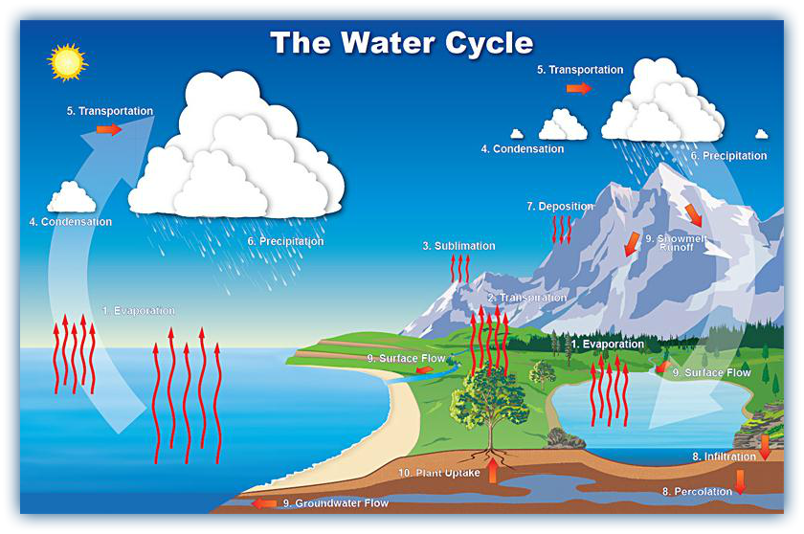
  Illustrate the Hydrological Cycle and Discuss its Significance to Plant Growth and Development

Slide 5
  Illustrate the Hydrological Cycle and Discuss its Significance to Plant Growth and Development
Plant can be 90% water
  All biochemical reactions in plants require water
  A part of respiration and transpiration
  Is one of the reactants for photosynthesis
  Activates germination
  Solvent for plant nutrients in soil

Slide 6
  Illustrate the Hydrological Cycle and Discuss its Significance to Plant Growth and Development
Plant can be 90% water
  All biochemical reactions in plants require water
  A part of respiration and transpiration
  Is one of the reactants for photosynthesis
  Activates germination
  Solvent for plant nutrients in soil
  Turgor pressure
    Pressure to inflate cells and hold plant erect
  Regulates opening and closing of stomata
    Water leaves plant through stomata
      Transpiration
        Regulation of plant temperature

Slide 7
  Discuss the Factors Involved in Soil Formation
Parent Material
  The material (bedrock) a soil was originally formed from
Climate
  Temperature, wind and humidity can cause different patterns of weathering, erosion and leaching
Topography
  Slope can affect moisture and erosion of soil
Biological Factors
  Plants, animals, microorganisms and humans can affect soil formation
Time
  How long each of the above factors have to interact with the soil is a component in soil formation
  Soil formation is continuous

Slide 8
  Examine the Physical and Chemical Properties of the Soil
Physical Properties
Chemical Properties
Horizonation
  The layers that make up a soil profile
  Parallel with ground surface
  Can show soil formation process
Soil color
  Can indicate soil components (ex. minerals, decomposed organic matter)
Soil texture
  The proportion of the soil separates that make up the mineral component of soil
    Sand, silt, clay
Soil structure
  The arrangement of the solid parts of the soil and of the pore (air) space between them
  How soil clumps or binds together
Soil consistence
  How easily soil clumps can be broken apart
  Depends on moisture content
    Moist, wet, dry
Bulk density
  How heavy soil is in relation to its volume
Cation exchange capacity
  How many cations (positively charged ions) a soil can hold
  How negatively charged a soil is
pH
  Indication of the acidity pH below 7.0) or alkalinity (pH above 7.0) of a soil

Slide 9
  Appraise the Importance of Organic Substances to Soil Health
Organic Substances
  Anything that contains carbon compounds that were formed by living things
    Lawn clippings, leaves, stems, branches, moss, algae, manure, sewage sludge, sawdust, insects, earthworms, microbes

Slide 10
  Appraise the Importance of Organic Substances to Soil Health
Importance of Organic Substances
  Change the amount of nitrogen that is available to plants
  Change the amount of other nutrients available
  Change the way the soil sticks together
  Change the number and type of organisms present in the soil

Slide 11
  Identify Factors that Lead to Soil Degradation
Soil Degradation
  A process that leads to decline in the fertility or future productive capacity of soil as a result of human activity
    Erosion
    Soil compaction
    Low organic matter
    Loss of soil structure
    Poor internal drainage
    Salinization
    Soil acidity problems

Slide 12
  Identify Factors that Lead to Soil Degradation
Causes of Soil Degradation
  Land clearance
    Clearcutting and deforestation
  Agricultural depletion of soil nutrients through poor farming practices
  Livestock
    Overgrazing and over drafting
  Inappropriate irrigation and over drafting
  Soil contamination
  Vehicle off-roading
  Urban sprawl
  Quarrying
  Monoculture

